Slide 1
Chapter 11 – Neural Nets
Data Mining for Business Analytics in R
Shmueli, Bruce, Yahav, Patel & Lichtendahl

Slide 2
Basic Idea
Combine input information in a complex & flexible neural net “model”
Model “coefficients” are continually tweaked in an iterative process
The network’s interim performance in classification and prediction informs successive tweaks

Slide 3
Network Structure
Multiple layers
Input layer (raw observations)
Hidden layers
Output layer
Nodes
Weights (like coefficients, subject to iterative adjustment)
Bias values (also like coefficients, but not subject to iterative adjustment)

Slide 4
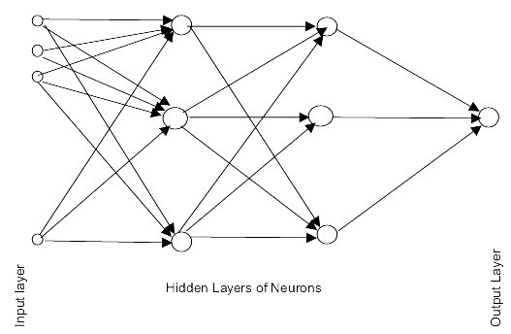
Schematic Diagram

Slide 5
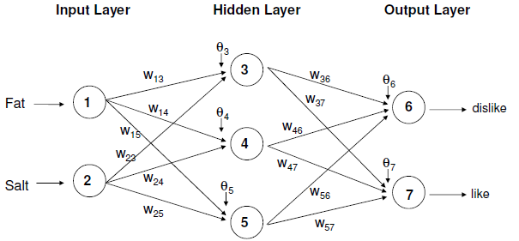
Example – Using fat & salt content to predict consumer acceptance of cheese
Circles are nodes, w_{ij} on arrows are weights, and ϴ_{j} are node bias values

Slide 6
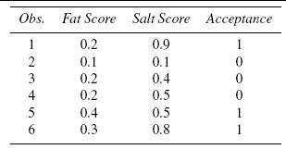
Tiny Example - Data
1

Slide 7
Moving Through the Network

Slide 8
The Input Layer
For input layer, input = output
E.g., for record #1:
Fat input = output = 0.2
Salt input = output = 0.9
Output of input layer = input into hidden layer

Slide 9

The Hidden Layer
In this example, it has 3 nodes
Each node receives as input the output of all input nodes
Output of each hidden node is some function of the weighted sum of inputs

Slide 10
The Weights
The weights θ (theta) and w are typically initialized to random values in the range -0.05 to +0.05
Equivalent to a model with random prediction (in other words, no predictive value)
These initial weights are used in the first round of training

Slide 11
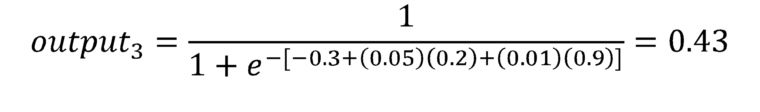
Output of Node 3 if g is a Logistic Function

Slide 12
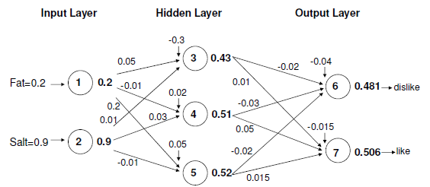
Initial Pass of the Network
Node outputs (bold) using first record in tiny example, and logistic function

Slide 13
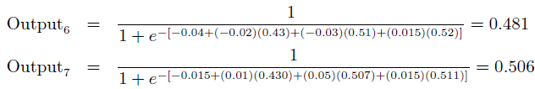
Output Layer
The output of the last hidden layer becomes input for the output layer
Uses same function as above, i.e. a function g of the weighted average
(-0.02)(0.52)

Slide 14
Mapping the output to a classification
Output = 0.506 for “like” and 0.481 for “dislike”
So classification, at this early stage, is“like”

Slide 15

Relation to Linear Regression
A net with a single output node and no hidden layers, where g is the identity function, takes the same form as a linear regression model

Slide 16
Training the Model

Slide 17
Preprocessing Steps
Scale variables to 0-1
Categorical variables
If equidistant categories, map to equidistant interval points in 0-1 range
Otherwise, create dummy variables
Transform (e.g., log) skewed variables

Slide 18
Initial Pass Through Network
Goal: Find weights that yield best predictions
The process we described above is repeated for all records
At each record compare prediction to actual
Difference is the error for the output node
Error is propagated back and distributed to all the hidden nodes and used to update their weights

Slide 19
Back Propagation (“back-prop”)
Output from output node k:
Error associated with that node:
Note: this is like ordinary error, multiplied by a correction factor

Slide 20

Error is Used to Update Weights
l = constant between 0 and 1, reflects the “learning rate” or “weight decay parameter”

Slide 21
Why It Works
Big errors lead to big changes in weights
Small errors leave weights relatively unchanged
Over thousands of updates, a given weight keeps changing until the error associated with that weight is negligible, at which point weights change little

Slide 22
R Functions for Neural Nets
neuralnet (used here)
nnet (does not support multilayer networks)
Code for the tiny example:
nn <- neuralnet(Like + Dislike ~ Salt + Fat, data = df,
linear.output = F, hidden = 3)
# display weights
nn$weights
# display predictions
prediction(nn)
# plot network
plot(nn, rep="best")
Indicates 1 hidden layer with 3 nodes, the syntax hidden = 3,4 would mean 2 layers, 3 nodes in the first, 4 in the second

Slide 23
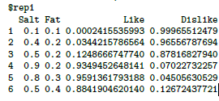
Predictions

Slide 24
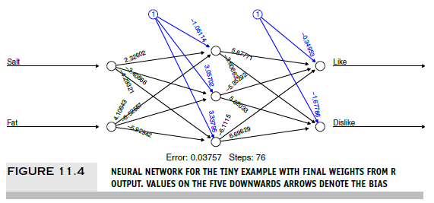

Slide 25
Confusion Matrix
(use predict from caret library)
library(caret)
predict <- compute(nn, data.frame(df$Salt, df$Fat))
predicted.class=apply(predict$net.result,1,which.max)-1
confusionMatrix(ifelse(predicted.class=="1", "dislike",
"like"), df$Acceptance)
output:
Reference
Prediction dislike like
dislike 3 0
like 0 3

Slide 26
Common Criteria to Stop the Updating
When weights change very little from one iteration to the next
When the misclassification rate reaches a required threshold
When a limit on runs is reached

Slide 27
Avoiding Overfitting
With sufficient iterations, neural net can easily overfit the data
To avoid overfitting:
Track error in validation data
Limit iterations
Limit complexity of network

Slide 28
User Inputs

Slide 29
Specify Network Architecture
Number of hidden layers
Most popular – one hidden layer
Number of nodes in hidden layer(s)
More nodes capture complexity, but increase chances of overfit
Number of output nodes
For classification with m classes, use m or m-1 nodes
For numerical prediction use one

Slide 30
Network Architecture, cont.
“Learning Rate”
Low values “downweight” the new information from errors at each iteration
This slows learning, but reduces tendency to overfit to local structure
“Momentum”
High values keep weights changing in same direction as previous iteration
Likewise, this helps avoid overfitting to local structure, but also slows learning

Slide 31
Arguments in neuralnet
hidden: a vector specifying the number of nodes per layer (thus specifying both the size and number of layers)
learningrate: value between 0 and 1

Slide 32
Advantages
Good predictive ability
Can capture complex relationships
No need to specify a model

Slide 33
Disadvantages
Considered a “black box” prediction machine, with no insight into relationships between predictors and outcome
No variable-selection mechanism, so you have to exercise care in selecting variables
Heavy computational requirements if there are many variables (additional variables dramatically increase the number of weights to calculate)

Slide 34

Deep Learning The most active application area for neural nets
In image recognition, pixel values are predictors, and there might be 100,000+ predictors – big data! (voice recognition similar)
Deep neural nets with many layers (“neural nets on steroids”) have facilitated revolutionary breakthroughs in image/voice recognition, and in artificial intelligence (AI)
Key is the ability to self-learn features (“unsupervised”)
For example, clustering could separate the pixels in this 1” by 1” football field image into the “green field” and “yard marker” areas without knowing that those concepts exist
From there, the concept of a boundary, or “edge” emerges
Successive stages move from identification of local, simple features to more global & complex features

Slide 35
Summary
Neural networks can be used for classification and prediction
Can capture a very flexible/complicated relationship between the outcome and a set of predictors
The network “learns” and updates its model iteratively as more data are fed into it
Major danger: overfitting
Requires large amounts of data
Good predictive performance, yet “black box” in nature
Deep learning, very complex neural nets, is effective in image recognition and AI

